Slide 1


K.RAMAKRISHNAN COLLEGE OF TECHNOLOGY (AUTONOMOUS), TRICHY
STREAMLINING HOSTEL OPERATIONS THROUGH AUTOMATION
BATCH – 16
GUIDE :VALLI PRIYADHARSHINI.K ME.,(Phd).,
PRESENTED BY
811721104067- MEGASRI A
811721104087- SANGEETHA S
811721104101- SRINIDHI M
811721104119- VARSHINI D

Slide 2
PRESENTATION OVERVIEW
Objective
Abstract
Introduction
Literature Review
Existing system
Proposed system
Hardware and Software Requirements
Modules
Results and Discussion
Conclusion

Slide 3
OBJECTIVE
The objective of a Hostel Management System is to streamline and automate administrative processes for managing hostels or similar accommodations. It efficiently handles tasks like student/guest registration, room allocation, fee collection, inventory management, attendance tracking, and communication between administration and residents.
Implementing an HMS enhances efficiency, accuracy, and transparency in daily operations. Additionally, features like online booking, payment gateways, and reporting tools improve the overall experience for both administrators and residents.

Slide 4
ABSTRACT
The Hostel Management framework is a web application designed to manage various hostel activities. It aims to reduce manual tasks and simplify hostel allocation for students and administrators. The system automates student selection from the waiting list, mess billing, out-pass generation, and complaint registration. Students receive notifications via email, while parents are informed about their ward's presence in the hostel and curricular updates with a single touch.

Slide 5
INTRODUCTION
A common problem in hostel management systems is inefficient record-keeping and communication. Traditional methods rely on manual data entry and paper-based systems, causing errors, delays, and difficulty in accessing information.
Issues may also arise in securely managing guest information; without robust data protection, sensitive personal data of residents could be at risk, leading to legal and reputational consequences.
Additionally, the lack of integration with online booking platforms and payment gateways limits compatibility with popular booking sites, resulting in missed opportunities for customers and revenue.

Slide 6
LITERATURE SURVEY
S.NO | JOURNAL NAME & YEAR | AUTHOR NAME | TITLE | METHODOLOGY | MERITS | DEMERITS
1 | International Journal of Scientific and Research Publications, 2014 | Dr. S. Balaji, K. Siva Kumar | Design and Implementation of Hostel Management System Using Arduino | It employs RFID technology for identifying students and monitoring their activities within the hostel premises. | The system offers real-time monitoring of student attendance, meal distribution and access control. | Limited scalability might be a concern, and the initial setup cost involving Arduino boards.
2 | International Journal of Computer Science and Information Technologies, 2016 | S. A. Akinboro, O. G. Akinboro, O. J. Akinboro | Hostel Management System | The study presents a web- based hostel management system developed using PHP and MySQL database. | The system offers accessibility from anywhere with an internet connection, facilitating convenient hostel administration. | Security concerns may arise due to potential vulnerabilities in web applications.

Slide 7
LITERATURE SURVEY
S.NO | JOURNAL NAME & YEAR | AUTHOR NAME | TITLE | METHODOLOGY | MERITS | DEMERITS
3 | International Journal of Advanced Research in Computer Science and Software Engineering, 2017 | A. A. Adegoke, O. E. Adeyemo, O. O. Onaolapo | Development of a Hostel Management System for Higher Institutions | The research proposes a hostel management system built using Java programming language with MySQL database. | The system offers platform independence and scalability owing to its Java-based architecture. | Compatibility issues may arise with different operating systems and database environment.
4 | International Journal of Advanced Engineering Research and Science (IJAERS), 2019 | P. Rathod, P. Kumbhar, V. Wadhai | Hostel Management System Using Android Application | The system utilizes Java for Android development and SQLite for local database storage. | Mobile accessibility enhances convenience for both administrators and residents. | Limited scalability compared to web-based systems.

Slide 8
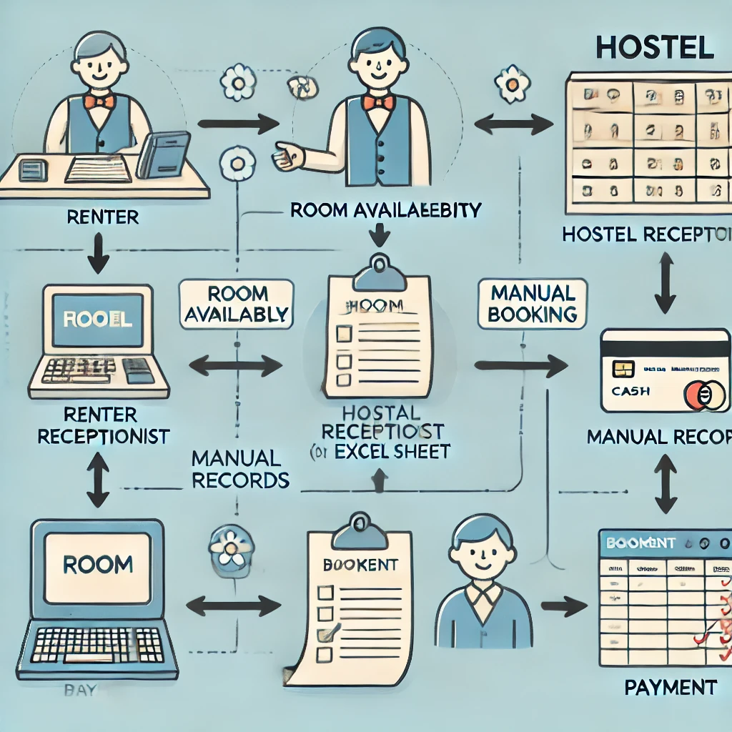
EXISTING SYSTEM DIAGRAM

Slide 9
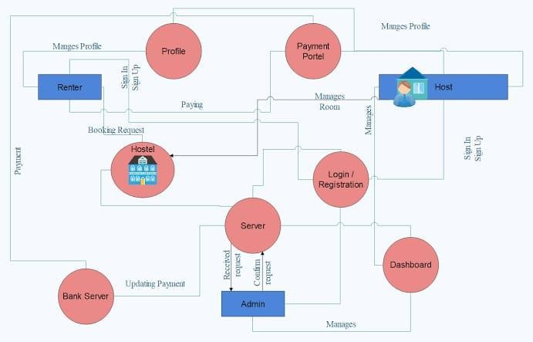
PROPOSED SYSTEM
ARCHITECTURE
.

Slide 10
HARDWARE AND SOFTWARE REQUIREMENTS
HARDWARE REQUIREMENTS:
Operating system : Windows 10
Coding Language : HTML, JAVA AND JS
Tool : VS CODE
Database : MySQL
SOFTWARE REQUIREMENTS:
System : Pentium I7
Hard Disk : 500 GB
Monitor : 15 VGA Color
Mouse : Logitech
Ram : 8GB

Slide 11
MODULES IN PROJECT
User and Hostel Management Module
Booking and Payment Module
Admin Dashboard Module
Feedback and Notification Module

Slide 12
SUMMARY OF MODULE 1
User and Hostel Management Module
Manages user registration, login, profile updates, and hostel listings.
Processes:
Registration and Login: Users (Renters and Hosts) sign up and log in.
Profile and Listing Management: Users update profiles; Hosts add and edit room listings.
Room Search: Renters search for available rooms based on preferences.

Slide 13
SUMMARY OF MODULE 2
Booking and Payment Module
Facilitates booking requests and handles secure payments.
Processes:
Booking Request and Confirmation: Renters request bookings; Hosts approve or reject.
Payment Processing: Renters complete payments via a secure payment gateway.

Slide 14
SUMMARY OF MODULE 3
Admin Dashboard Module
Enables Admin to monitor and manage system activities.
Processes:
User and Booking Oversight: Admin manages users and booking activities.
Report Generation: Admin generates reports on system usage and transactions.

Slide 15
SUMMARY OF MODULE 4
Feedback and Notification Module
Gathers user reviews and manages notifications.
Processes:
Feedback Collection: Renters provide reviews for hostels.
Notifications: Sends booking confirmations, payment receipts, and alerts.

Slide 16
Results and Discussion
Feedback Module: Collects and analyzes resident feedback to improve hostel services and satisfaction.
Academic Integration: Syncs with student databases and course schedules for seamless room allocation based on enrollment.
Sustainability Features: Implements energy-saving fixtures and waste management, tracking metrics for resource optimization.
Analytics and Reporting: Provides data insights to support decision-making and enhance operational efficiency.
Performance Evaluation: Assesses user satisfaction, system speed, data accuracy, resource usage, and error rates for continuous improvement.

Slide 17
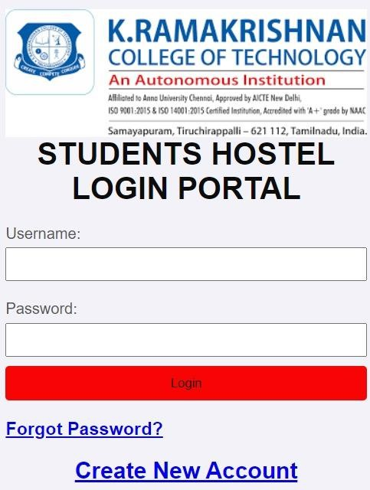
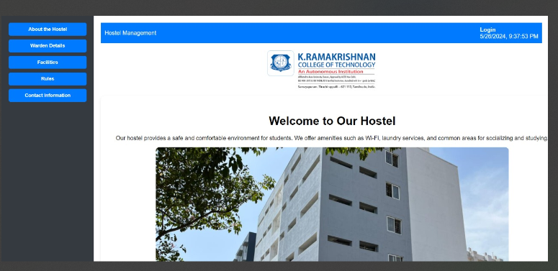
Results and Discussion

Slide 18
Conclusion
The implementation of a hostel management system enhances efficiency, organization, and effectiveness in managing hostel operations. The system automates tasks such as student registration, room allocation, fee management, and maintenance tracking.
By adopting this system, administrators can streamline processes, reduce errors, and improve communication with students and staff.
It provides real-time information access, enabling quick decision-making and better resource utilization. Overall, the system optimizes operations and offers a seamless experience for both residents and staff.

Slide 19
THANK YOU

